Slide 1
Gall bladder
The gallbladder is a pear-shaped, hollow structure located under the liver and on the right side of the abdomen. Its primary function is to store and concentrate bile, a yellow-brown digestive enzyme produced by the liver. The gallbladder is part of the biliary tract.

Slide 2
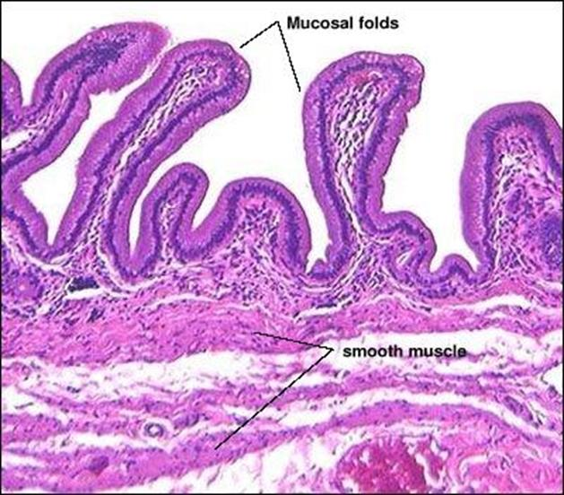
NORMAL GALLBLLADER

Slide 3
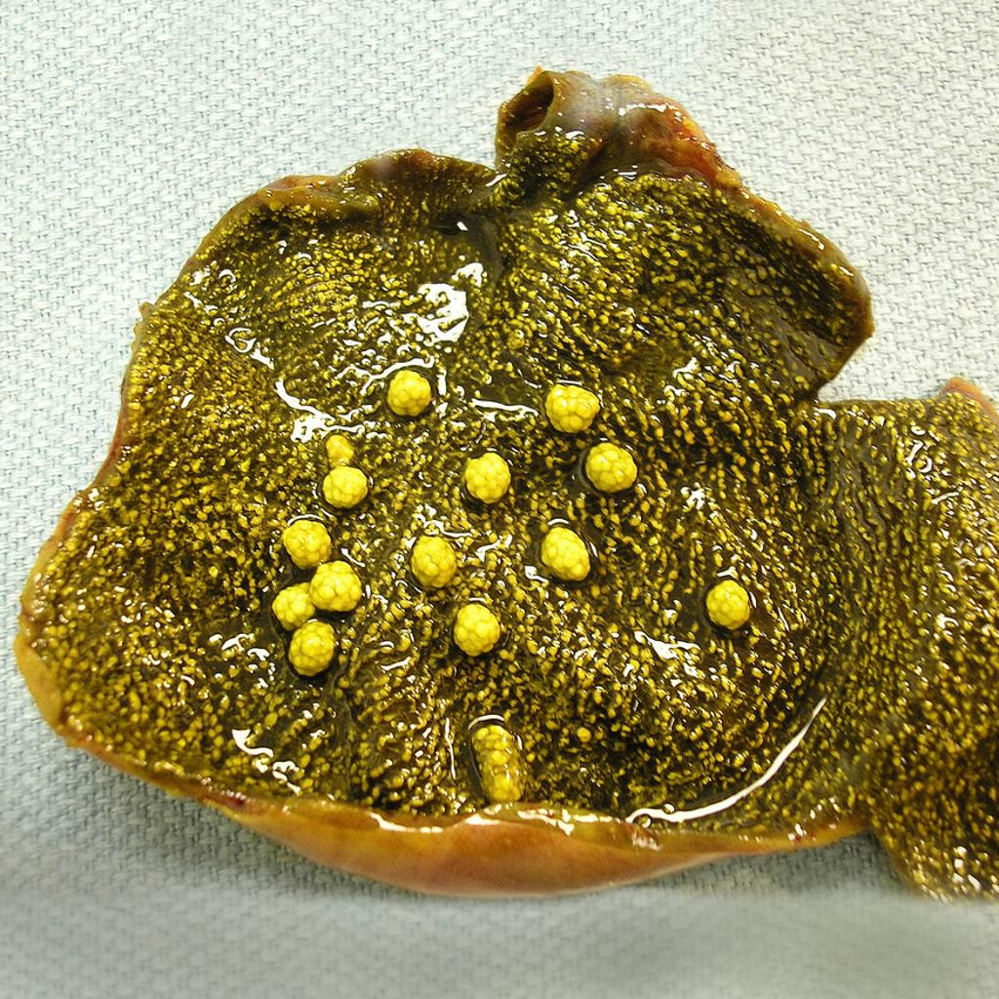
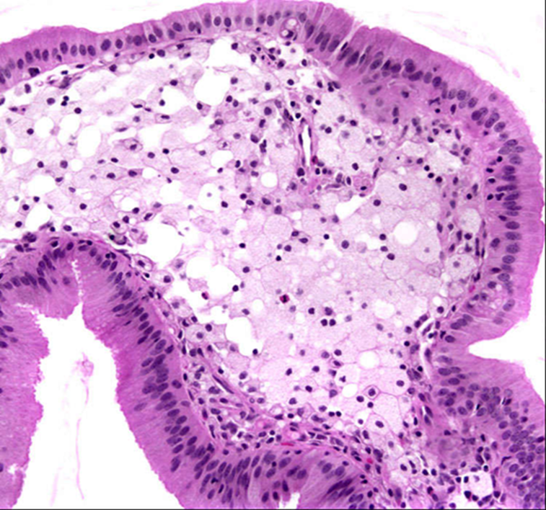
CHOLESTROLOSIS

Slide 4
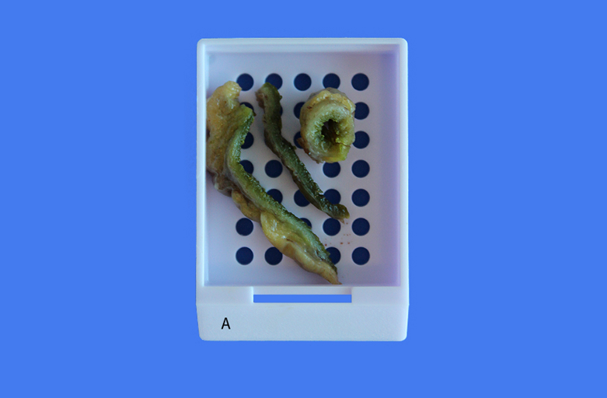

Slide 5
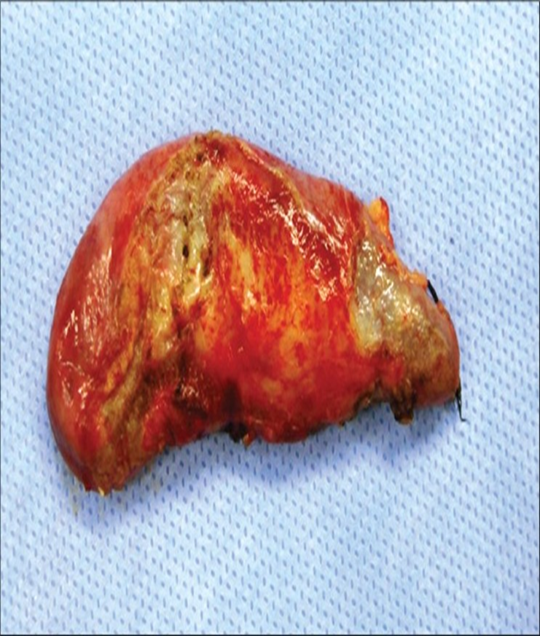
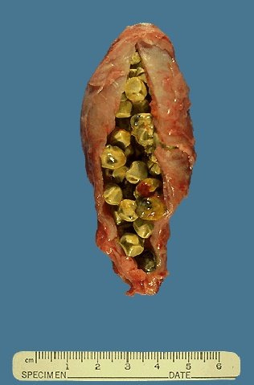
ACUTE CHOLECYSTITIS CHRONIC CHOLECYSTITIS

Slide 6
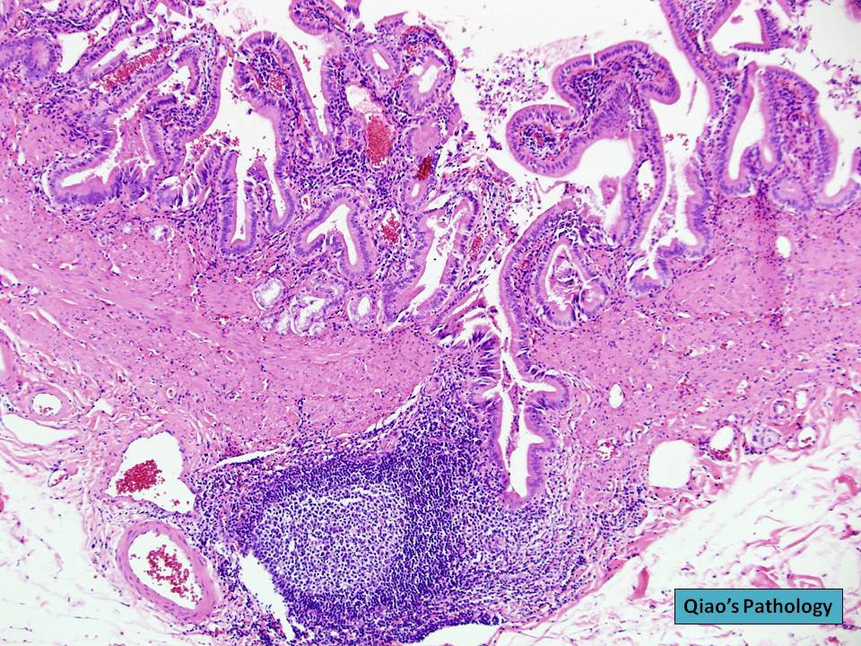
CHRONIC CHOLECYSTITIS

Slide 7
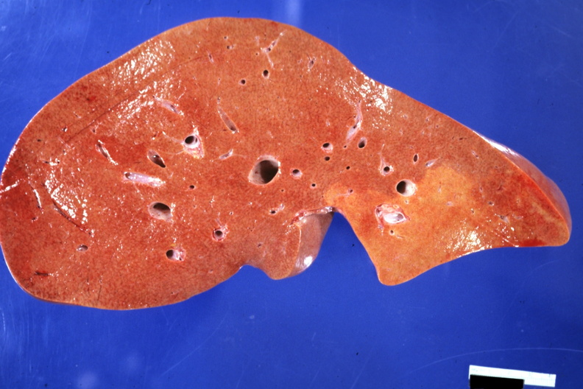
NORMAL LIVER

Slide 8
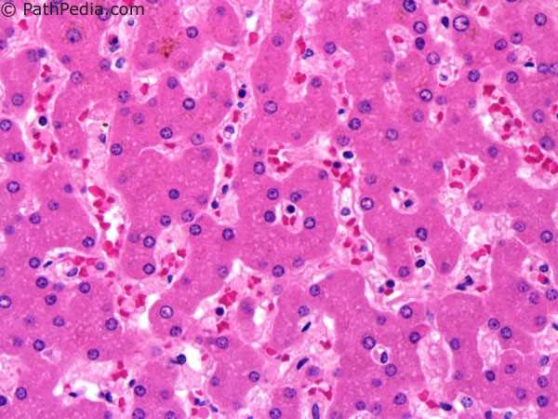
NORMAL LIVER HISTOLOGY

Slide 9
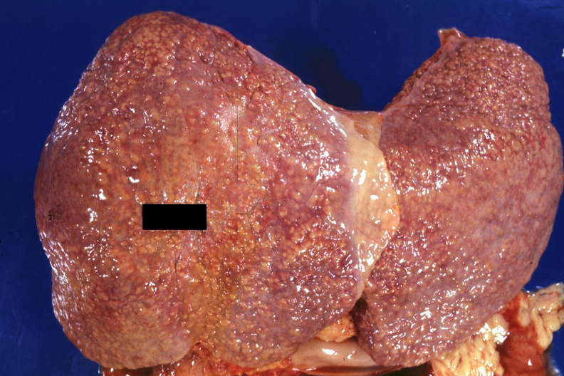
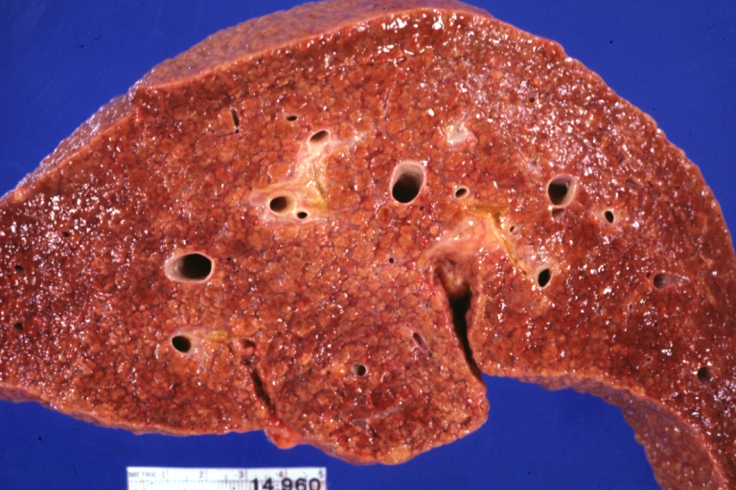
CIRRHOSIS

Slide 10
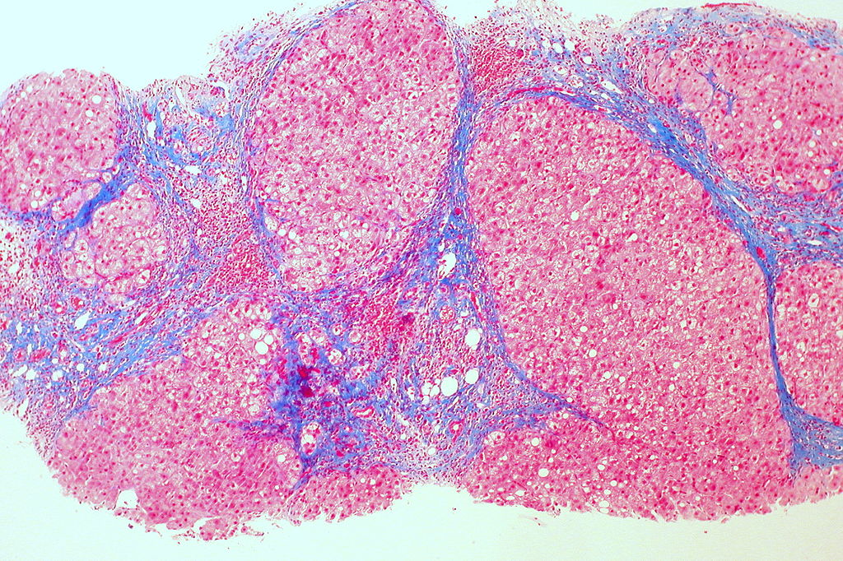
CIRRHOSIS- LIVER BIOPSY

Slide 11
FEMALE GENITAL TRACT
Uterus
Cervix
Fallopian tubes
ovaries

Slide 12
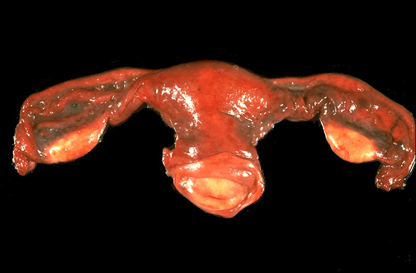
NORMAL

Slide 13
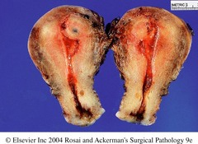
NORMAL UTERUS

Slide 14
FIBROID UTERUS (LEIOMYOMA)

Slide 15
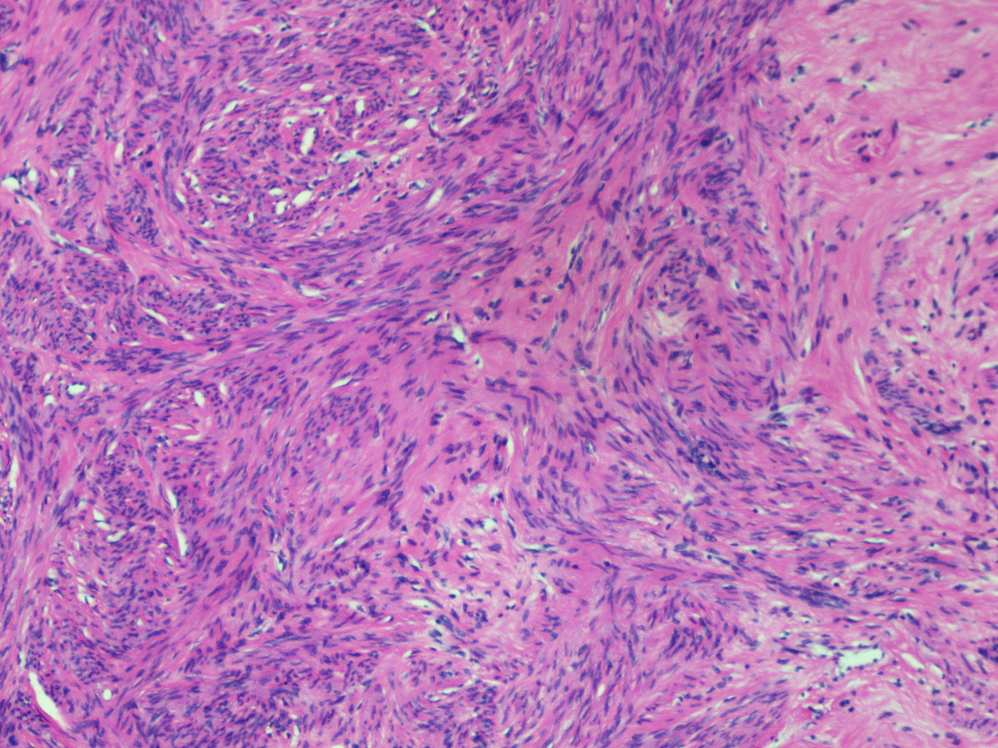
Leiyomyoma

Slide 16
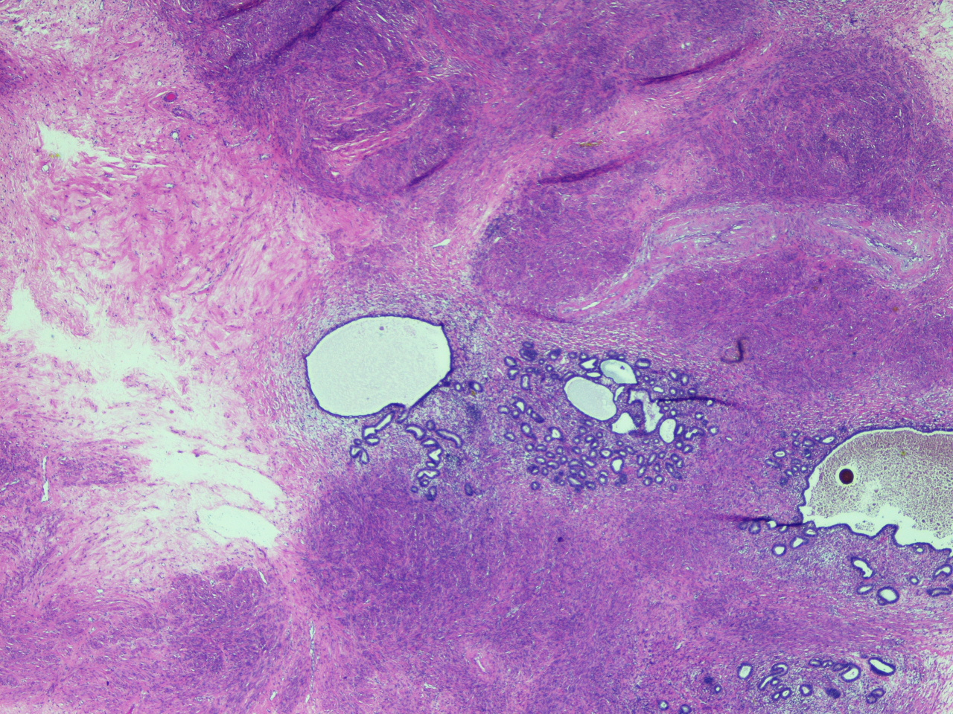
adenomyosis

Slide 17
ENDOMETRIAL carcinoma

Slide 18
ENDOMETRIAL Carcinoma

Slide 19
CERVIX
CONE BIOPSY
LLETZ
SMALL BIOSIES

Slide 20
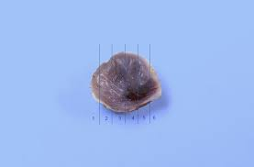
CONE BIOPSY

Slide 21
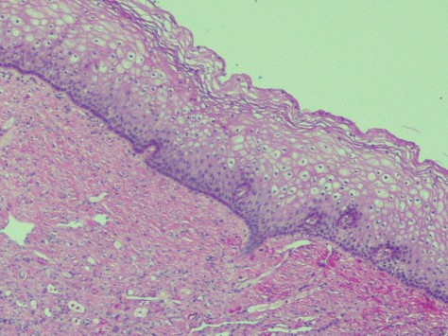
NORMAL CERVIX

Slide 22
HIGH GRADE SQUAMOUS INTRAEPITHELIAL LESION HSIL (cin 3)

